Slide 1
Chapter 8 Class Discussion

Slide 2
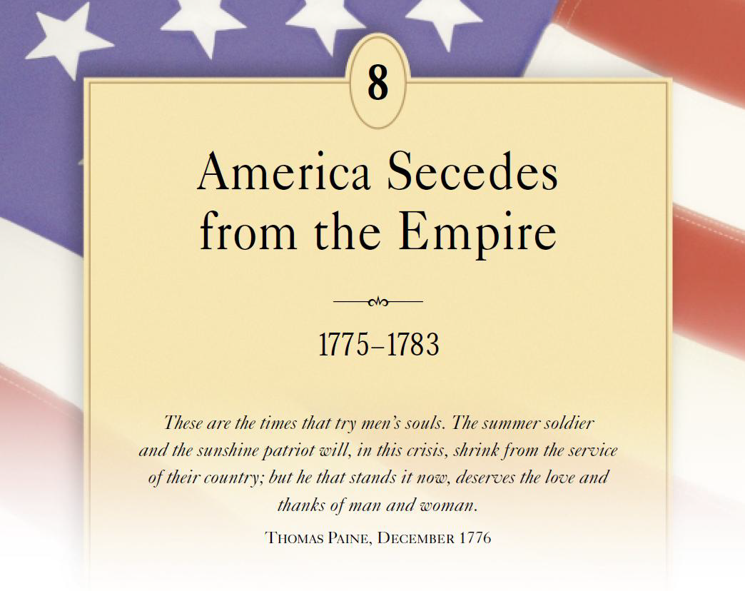

Slide 3
#1: Why were Americans so reluctant to break with Britain? What was the tipping point?
Second Continental Congress
Changing Sentiments: 1. cost of the war, 2. hurt feelings (King recruited Indians, slaves, and Hessians), and 3. forcing independence
(rejection of the Olive Branch petition & Prohibiting Act – blockade)
Bunker Hill & the Failed Conquest of Canada

Slide 4
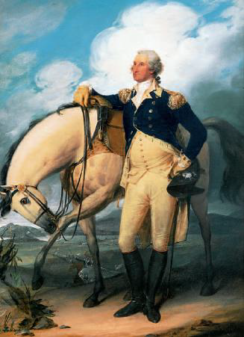

Slide 5
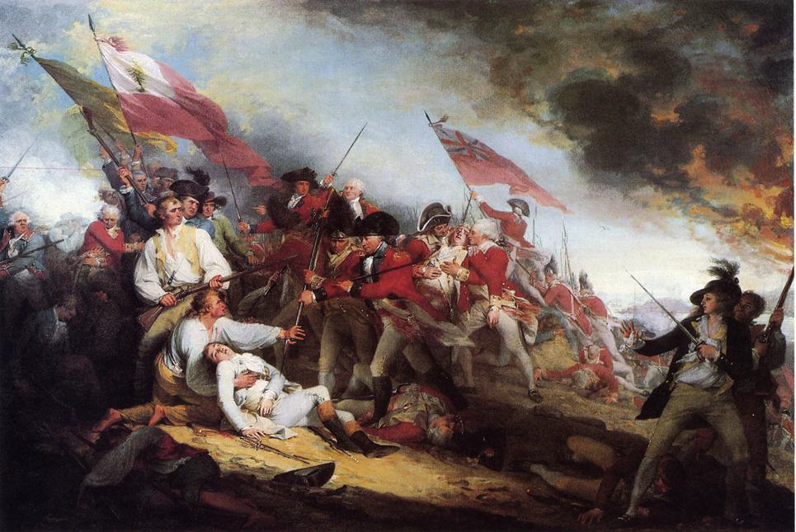

Slide 6
#2: What was Paine’s radical vision and why did that vision have such a strong appeal to many at the time? Why did conservatives develop a different vision of America’s future?
Loyalty to the Empire
1776 – publication of Common Sense
Smaller body controlling the larger one?
Creation of a “Republic” | NE town meetings
Cultivation of Civil Virtue
Natural Aristocracy – Stability of Social Order

Slide 7
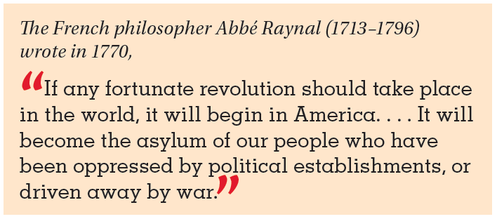
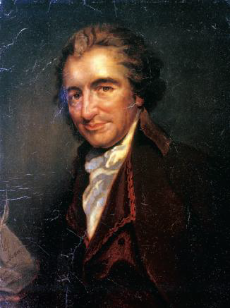
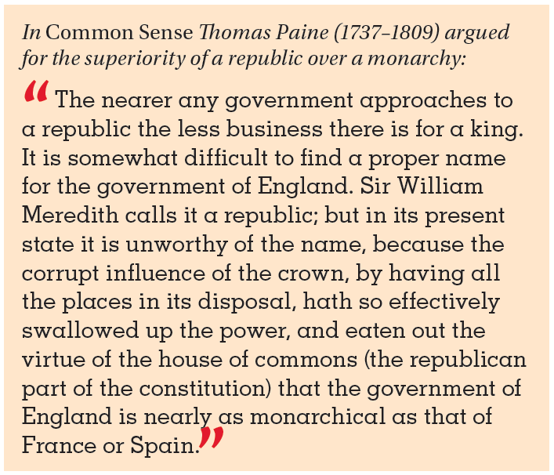

Slide 8
#3: Does the Declaration of Independence clearly make the argument that the colonies “ought to be independent”?
Lee’s Formal Resolution
The Committee of Five
Natural Rights, the Social Contract, and the Right to Revolution
Crimes of the Crown
“We must hang together, or we will hang separately.”

Slide 9
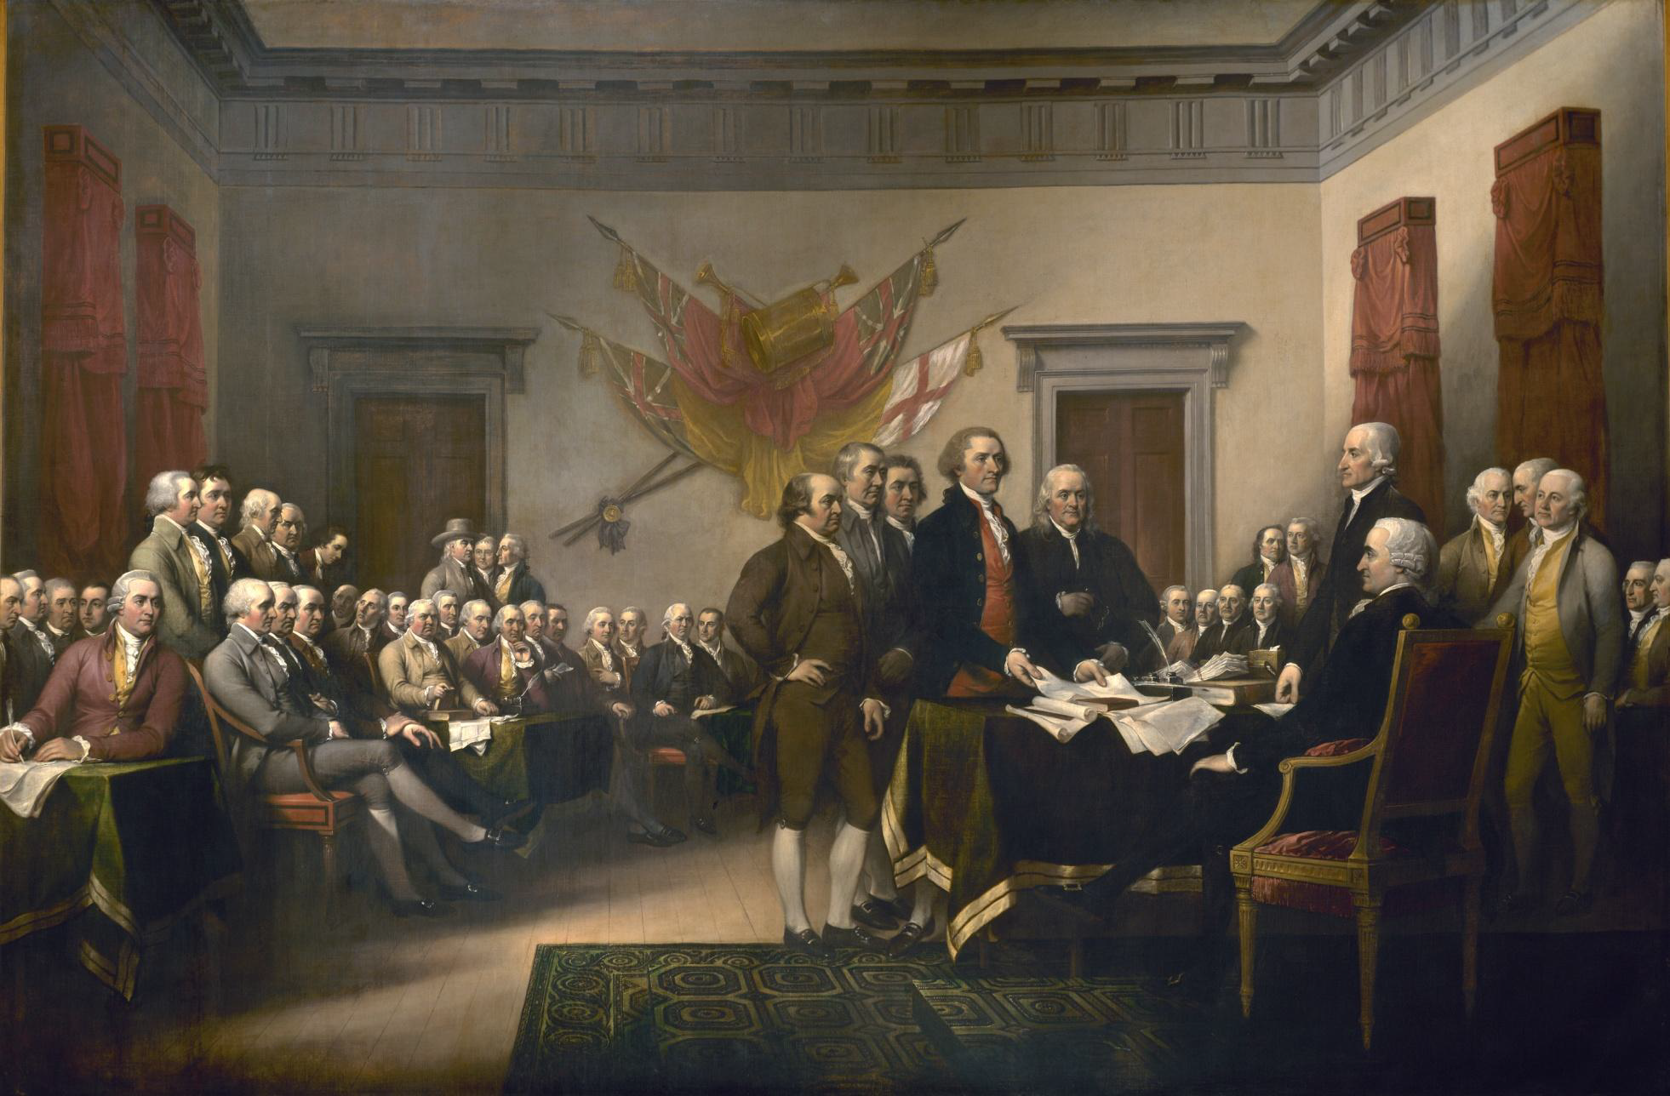

Slide 10
DOI *Questions to ponder*
What did the Founding Fathers leave out of the Declaration of Independence?
Do you think this document is still significant today?
If Thomas Jefferson never wrote this document, would history change?
“Life, Liberty, and the Pursuit of Happiness” are seen as unalienable rights…how does today’s America support and/or go against this notion?
What does this document say about systems of government?

Slide 11
#4: In what ways was the Revolution a civil war among Americans as well as a fight between Britain and those Americans seeking independence? Why have the Loyalist been forgotten in history?
•
Minority Movement
Patriots – characteristics of . . .
Loyalists – characteristics of . . .
The Loyalist Exodus

Slide 12
#5: What were the major turning points of the Revolutionary War? Which one was the most important?
General Washington at New Jersey Campaign
Burgoyne’s Blundering Invasion →
Strange French Bedfellows (Franco American Alliance of 1778) – Saratoga*
Colonial War becomes a World War (Armed Neutrality)
Yorktown* and the Final Curtain

Slide 13
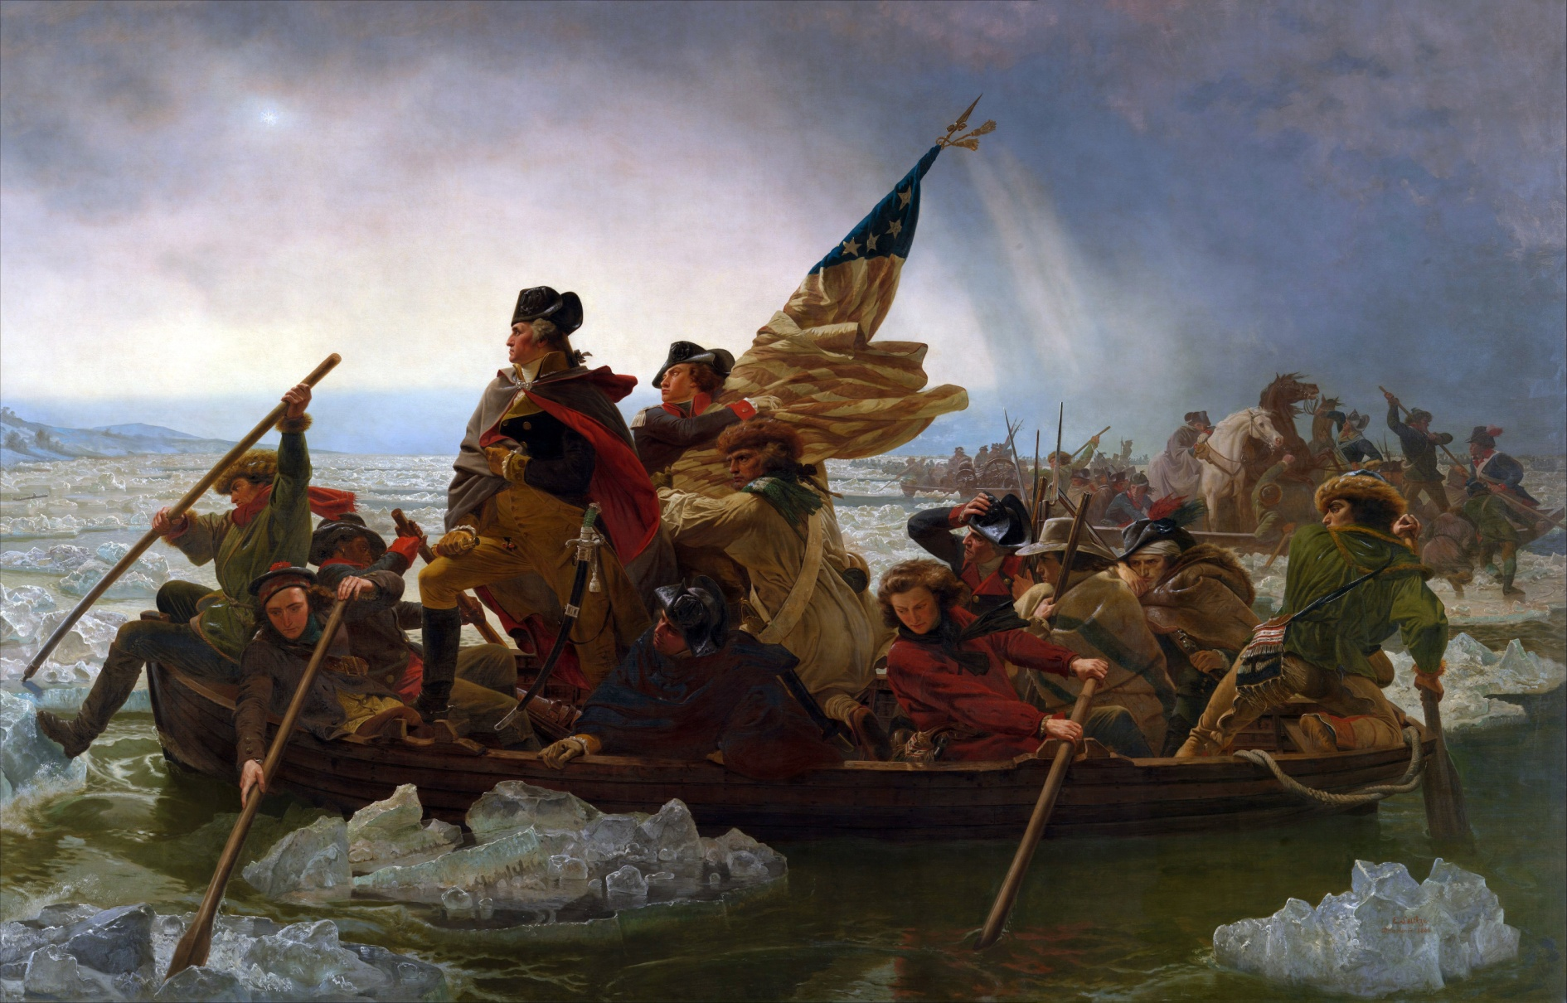

Slide 14
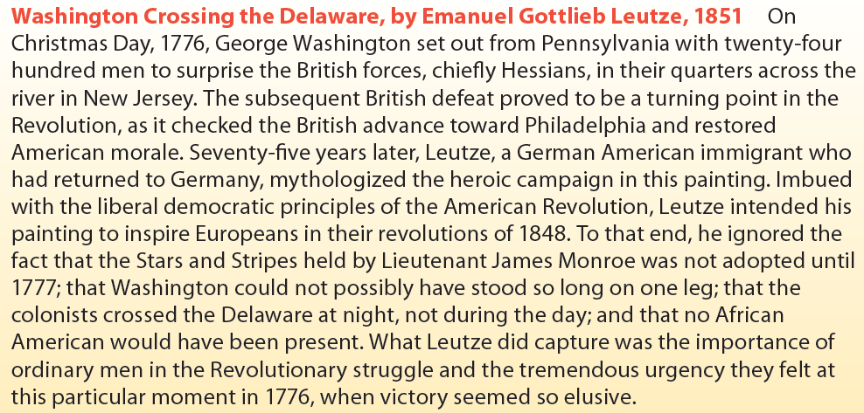

Slide 15
#6: What were the terms of the Paris Peace Treaty? Were the American’s being fair in the way they handled the peace negotiations?
Collapse of Lord North’s Tory regime
Franklin, J. Adams, and Jay
The Terms of Peace
Do you agree with the statement in the text: “America alone gained from the world-girdling war”? Why or why not?

Slide 16
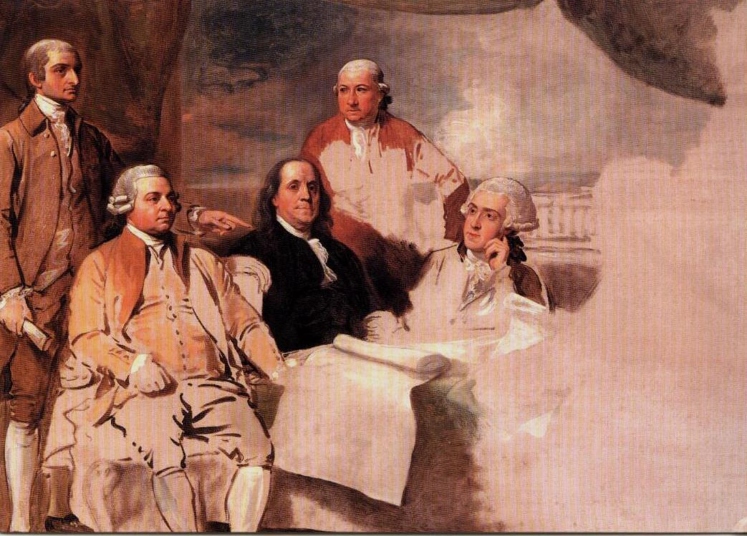

Slide 17
CREATE TWO T CHARTS
That look at the advantages and disadvantages of the Patriots and Loyalists during the war.

Slide 18
Would you rather be a patriot or a loyalist during the American Revolution?

